Slide 1
Life cycle analysis– How can we sustain our quality of life?
26/09/2026
Starter/R2R:
State the main pollutants from fossil fuels. | Where does acid rain come from? | What is a carbon footprint?
State two of the human activities that have the greatest effect on biodiversity? | What organelle is the location of photosynthesis? | What is the term for different populations or organisms living together?

Slide 2
Life cycle analysis - should I buy a new iphone?
26/09/2026
Starter/R2R:
State the main pollutants from fossil fuels. Sulphur dioxide Carbon Monoxide Nitrous oxides | Where does acid rain come from? SO₂ + NO₂ combining with H₂0 | What is a carbon footprint? The volume of CO2 released by your activities
State two of the human activities that have the greatest effect on biodiversity? Building/mining/waste/hunting/farming | What organelle is the location of photosynthesis? Chloroplast | What is the term for different populations or organisms living together? Community

Slide 3


Upcoming end of topic

Slide 4
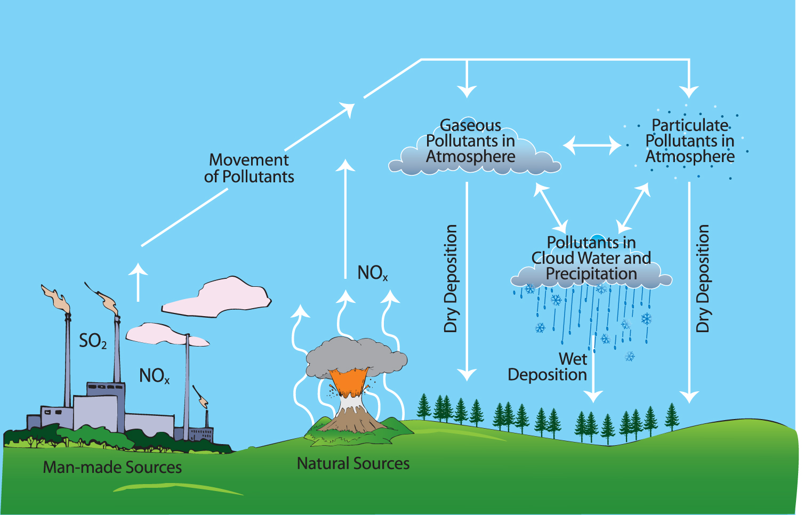
Previously…

Slide 5
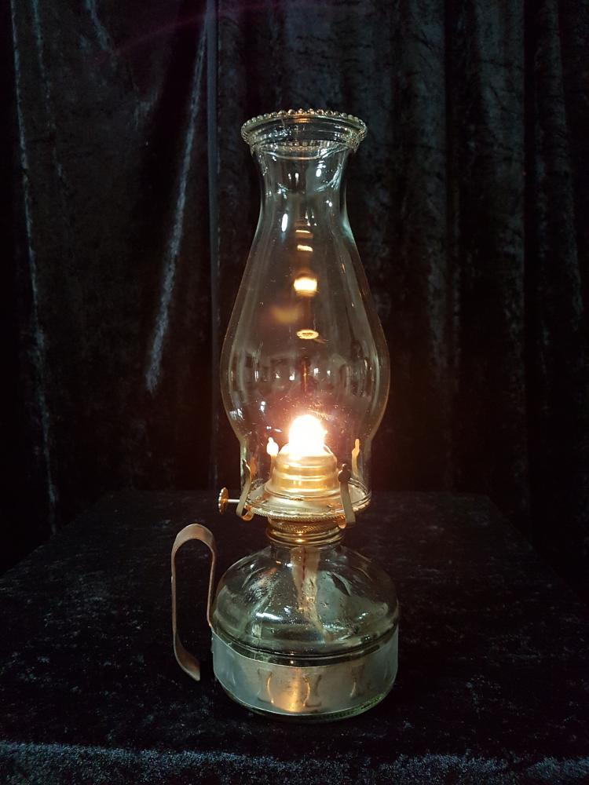
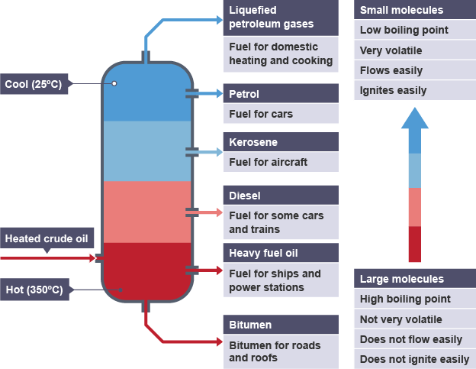
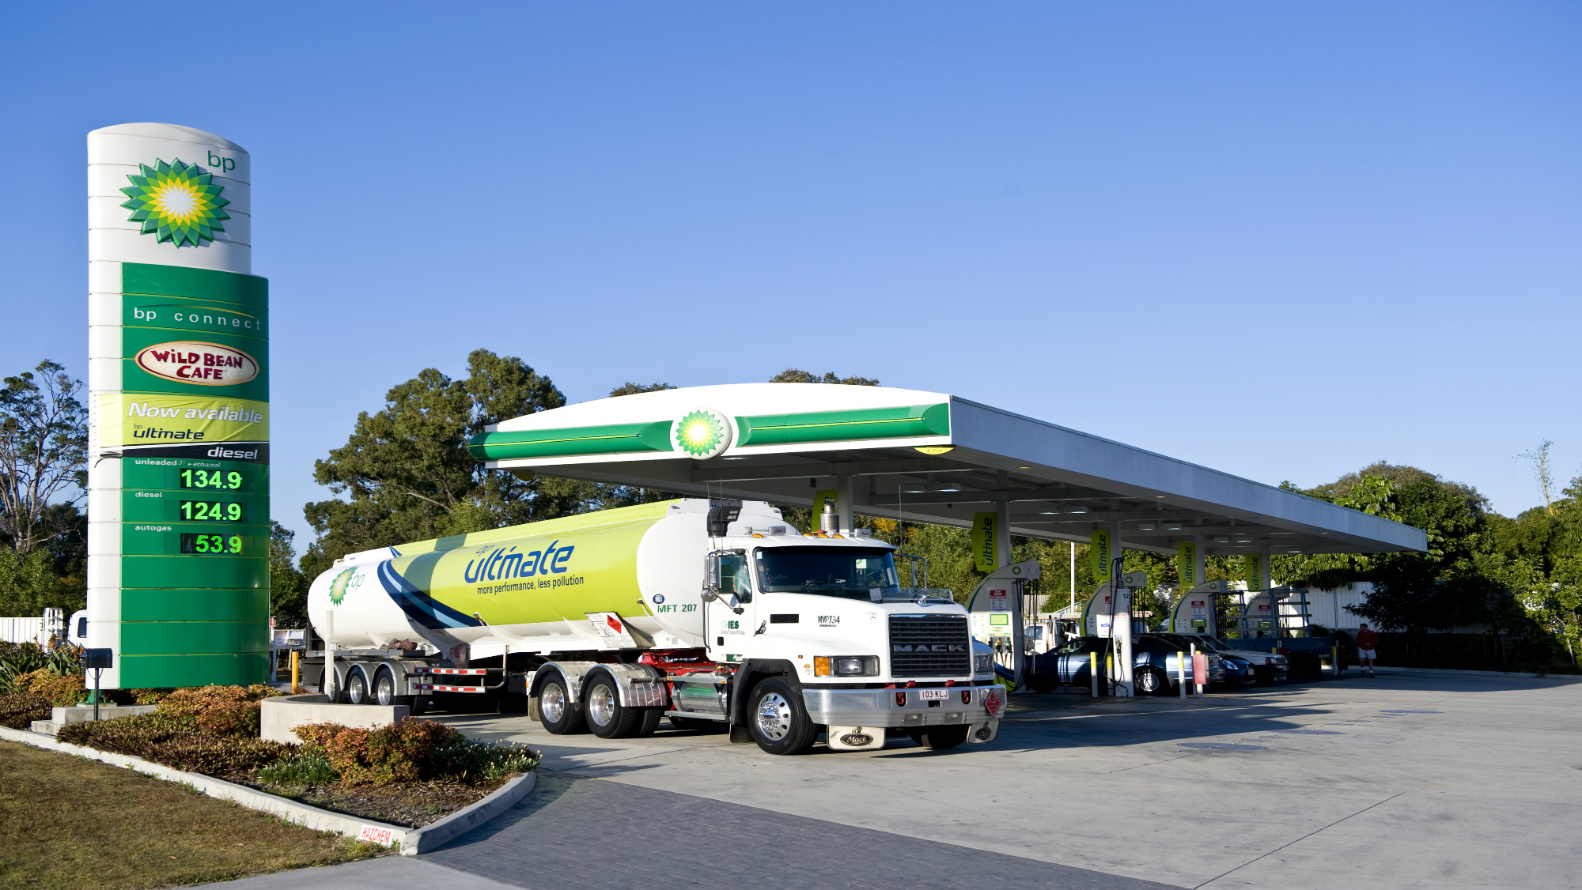
Previously…

Slide 6
Life cycle analysis
“Do we really need another iPhone?”

Slide 7
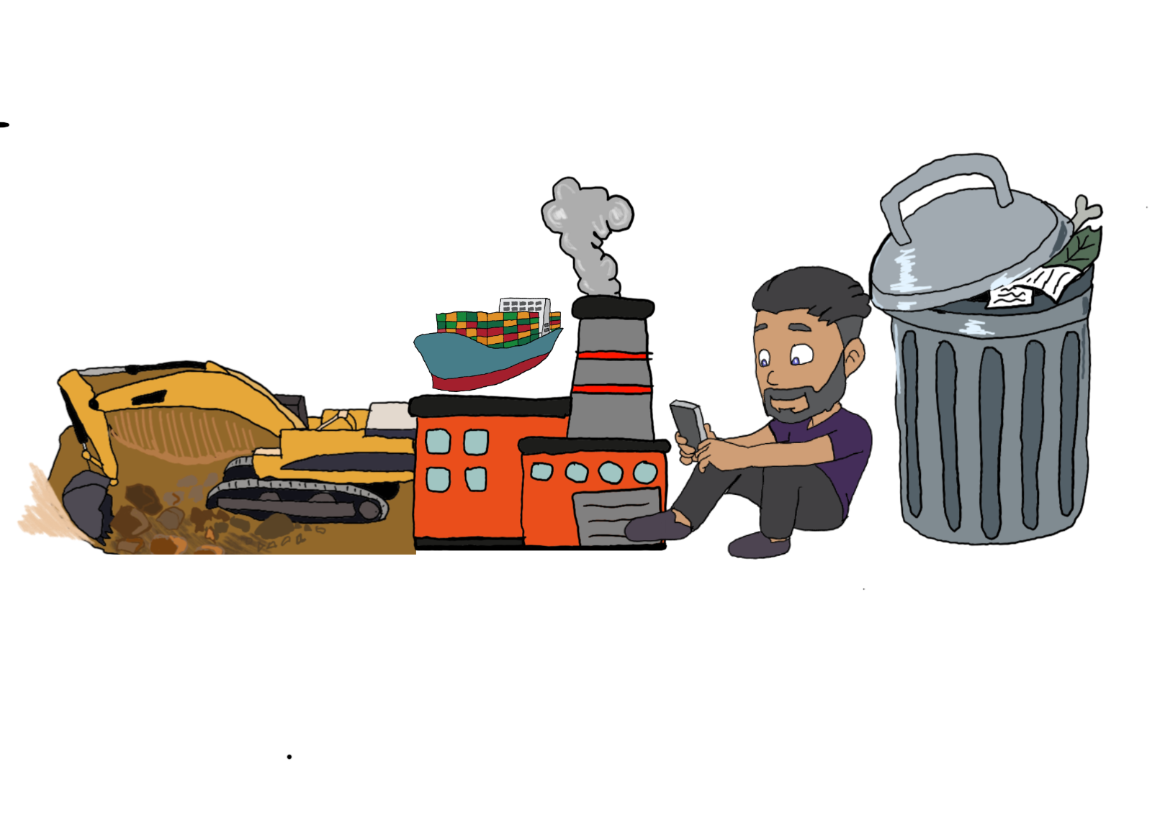
Life cycle analysis - Objectives - summary
State what is meant by life cycle analysis
Perform life cycle analysis
Challenge: Evaluate the usefulness of recycling
Key Words:
Life cycle analysis, Recycling, Extraction, Manufacturing, Disposal, Incineration, Sustainability

Slide 8
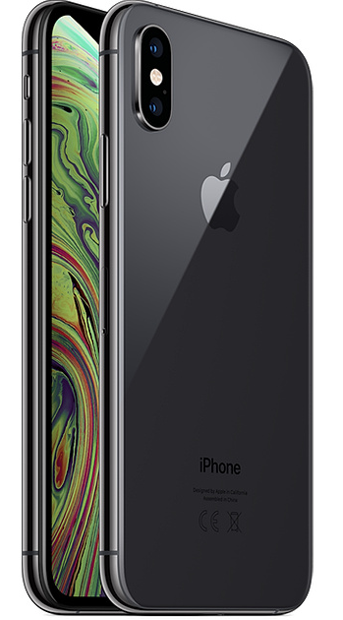
How much environmental damage does an iPhone do?

Slide 9
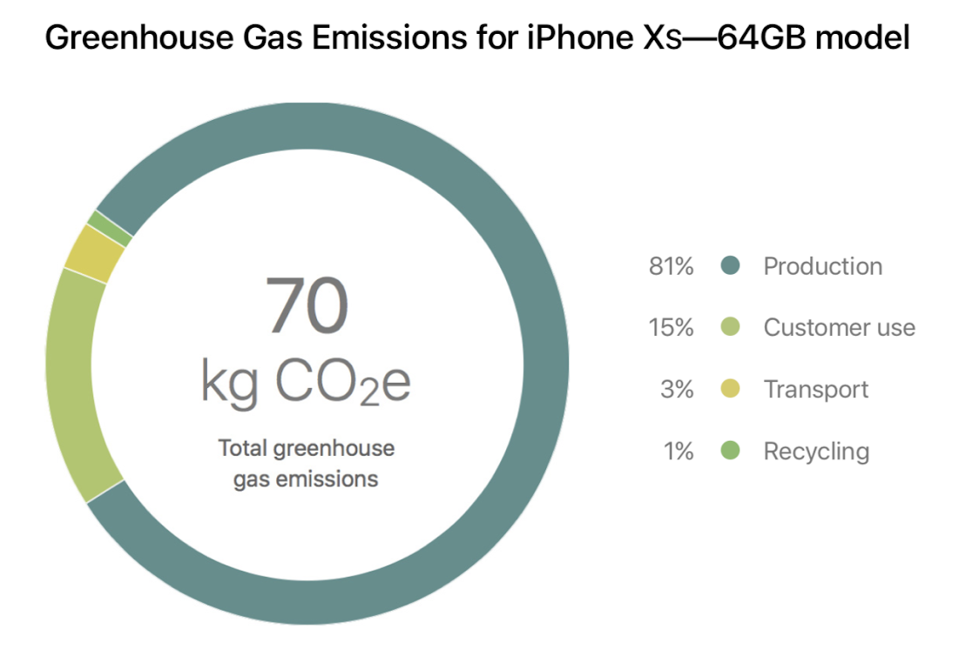
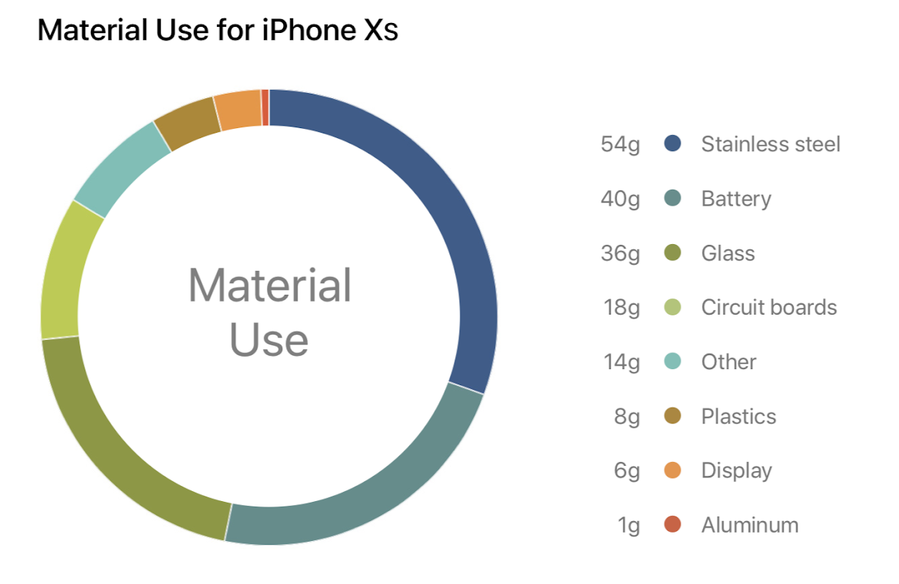

Slide 10
Simpsons environment
Simpsons, Homer cares about the environment and Buys an electric car (youtube.com)

Slide 11
Life cycle analysis
Life cycle analysis is a “cradle-to-grave” analysis of a product. There are four main stages of a product's life cycle:

Slide 12
Life cycle analysis
Life cycle analysis is a “cradle-to-grave” analysis of a product. There are four main stages of a product's life cycle:
Disposal
Manufacture
Use
(Extracting) Raw materials

Slide 14
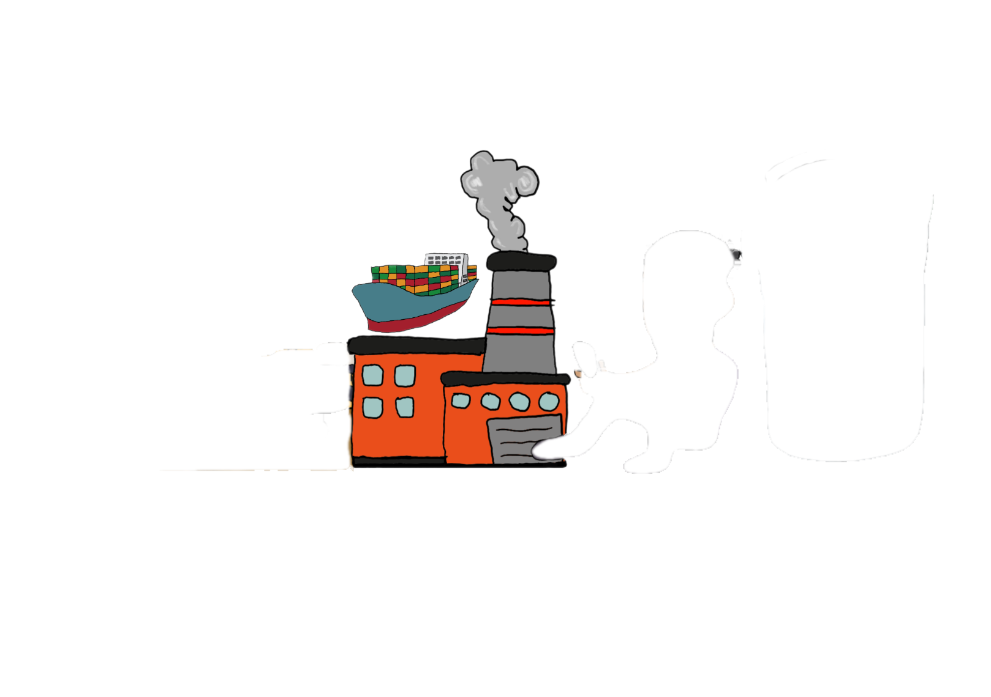
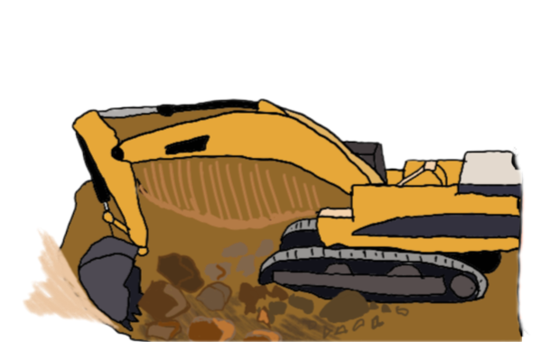

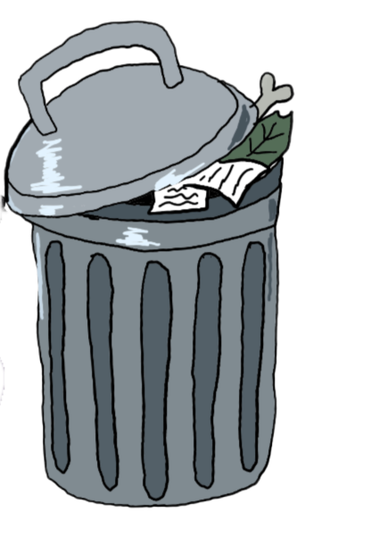
(Extracting) Raw materials
Manufacture and distribution
Using the product
Disposal

Slide 15
Life cycle analysis
Life cycle analysis is a “cradle-to-grave” analysis of a product. There are four main stages of a product's life cycle:
Raw materials - Extracting and processing the raw materials needed
Manufacturing - the product and its packaging
Use - Using the product during its lifetime
Disposal - Disposing of the product at the end of its useful life

Slide 16
Extracting the raw materials
See previous lessons on extracting metals and oil…
Blast furnace
Electrolysis
Fractional distillation

Slide 17
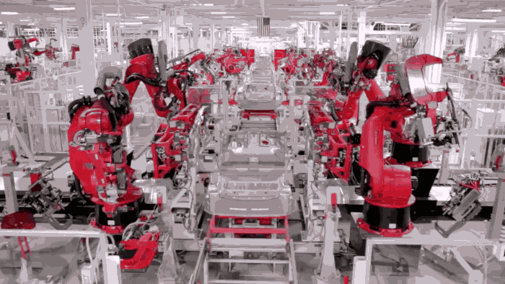
Manufacturing
Manufacturing is the process of producing a product from raw materials, usually in factories.
This is increasingly being automatised by robots.
This requires a large amount of energy.

Slide 18
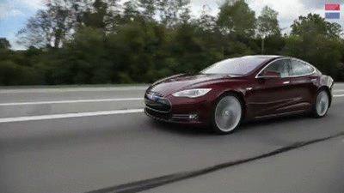
Use
Using a product such as a car or phone can also require energy.

Slide 19
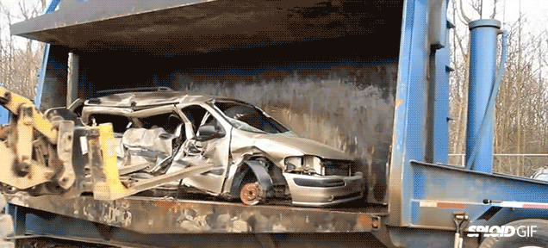
Disposal
Disposing of a product can cause pollution in landfills.
Also, if materials are burnt or incinerated this produces pollution.
At best, the raw materials are recycled and reused.

Slide 20
Life cycle analysis - Objectives - summary
State what is meant by life cycle analysis
Perform life cycle analysis
Challenge: Evaluate the usefulness of recycling
Key Words:
Life cycle analysis, Recycling, Extraction, Manufacturing, Disposal, Incineration, Sustainability

Slide 21
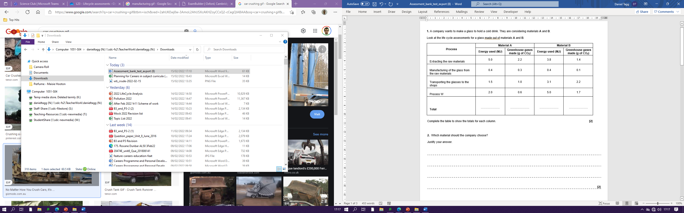

Slide 24
5.4
8.9
4.1
12.3

Slide 26
Six mark Question
A life cycle assessment assesses the environmental impact of products such as smartphones. Some activities in the life cycle of a smartphone are listed below.
Extracting oil from oil wells
Making plastics from oil
Obtaining copper from copper ore
Putting together all the components
Packing the phone in a box
Watching videos on the phone
Taking apart the phone
Recycling the copper from some of the phone components
Describe the four stages that are assessed in a life cycle assessment.
In your answer, give at least one example from the list above for each stage. [6 marks]

Slide 27
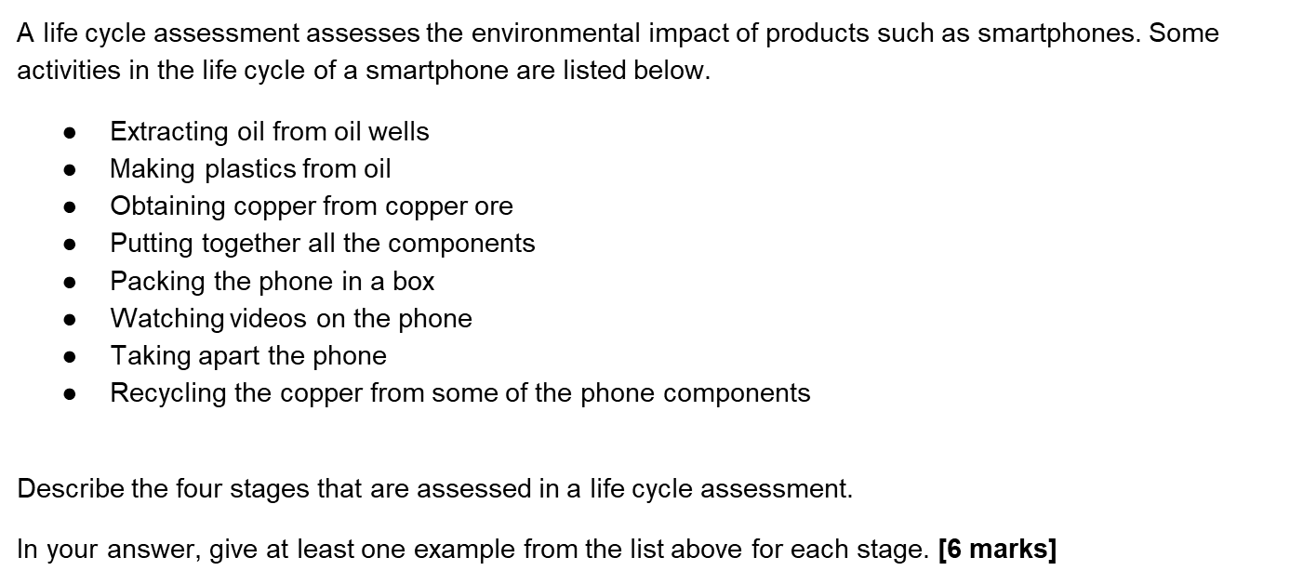







Six mark Question
The four stages of life cycle analysis are extraction of raw material, manufacturing, use and disposal.
Extracting oil from oil wells is an example of extraction, extraction of copper from copper ore is also another example of extraction.
Making plastics from oil is an example of manufacturing. Packing the phone in a box is also an example of manufacturing.
Watching videos on the phone is an example of phone use.
Taking apart the phone and then recycling the copper from some of the phone components is an example of how smartphones are disposed of.

Slide 28
A life cycle assessment assesses the environmental impact of products such as smartphones. Some activities in the life cycle of a smartphone are listed below.
Extracting oil from oil wells
Making plastics from oil
Obtaining copper from copper ore
Putting together all the components
Packing the phone in a box
Watching videos on the phone
Taking apart the phone
Recycling the copper from some of the phone components
Describe the four stages that are assessed in a life cycle assessment. In your answer, give at least one example from the list above for each stage. [6 marks]
A life cycle assessment assesses the environmental impact of products such as smartphones. Some activities in the life cycle of a smartphone are listed below.
Extracting oil from oil wells
Making plastics from oil
Obtaining copper from copper ore
Putting together all the components
Packing the phone in a box
Watching videos on the phone
Taking apart the phone
Recycling the copper from some of the phone components
Describe the four stages that are assessed in a life cycle assessment. In your answer, give at least one example from the list above for each stage. [6 marks]
A life cycle assessment assesses the environmental impact of products such as smartphones. Some activities in the life cycle of a smartphone are listed below.
Extracting oil from oil wells
Making plastics from oil
Obtaining copper from copper ore
Putting together all the components
Packing the phone in a box
Watching videos on the phone
Taking apart the phone
Recycling the copper from some of the phone components
Describe the four stages that are assessed in a life cycle assessment. In your answer, give at least one example from the list above for each stage. [6 marks]

Slide 29
Life cycle analysis - Objectives - summary
State what is meant by life cycle analysis
Perform life cycle analysis
Challenge: Evaluate the usefulness of recycling
Key Words:
Life cycle analysis, Recycling, Extraction, Manufacturing, Disposal, Incineration, Sustainability

Slide 30
Manufacture
Disposal
Use
(Extracting) Raw materials
Recycling???

